Slide 1
RealOffice Demo Presentation

Slide 2
Introduction
Use Cases
Architecture Design Pattern
Deployment View
Development View

Slide 3
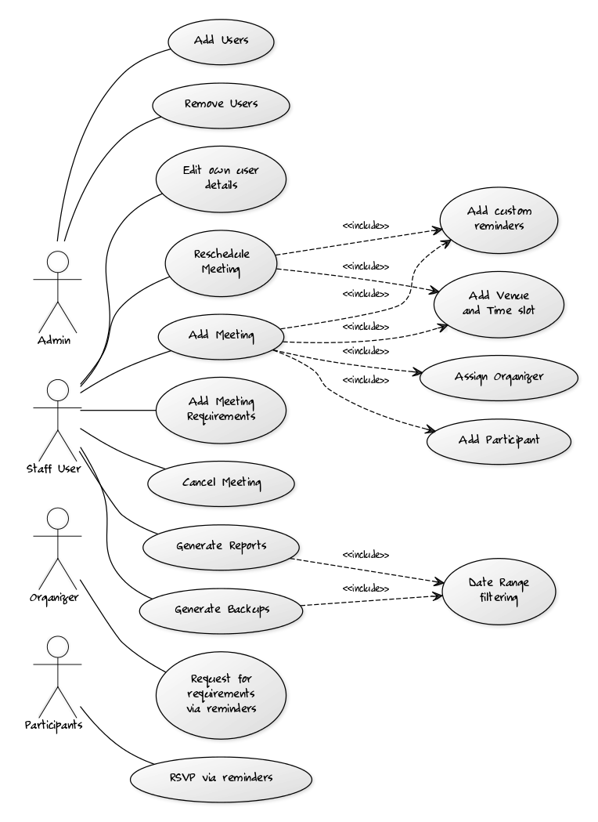
Use Cases

Slide 4
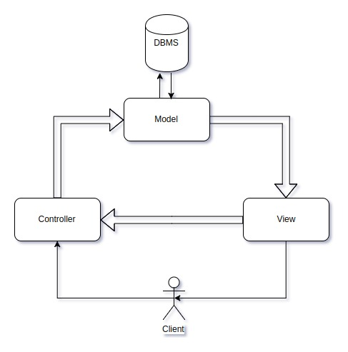
Architecture Design Pattern - MVC Framework

Slide 5
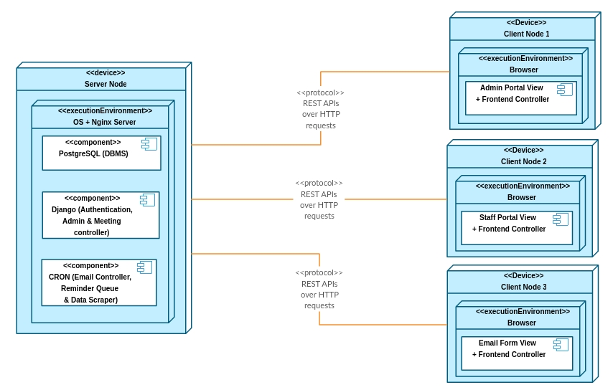
Deployment
View

Slide 6
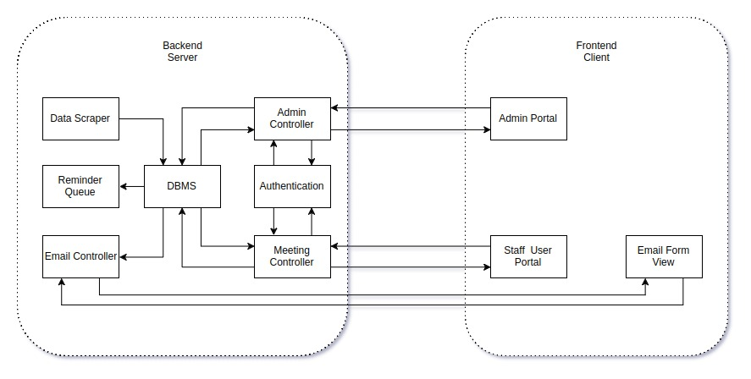
Development View

Slide 7
Demo 1-2
Add User
Remove User
From Admin User Perspective

Slide 8
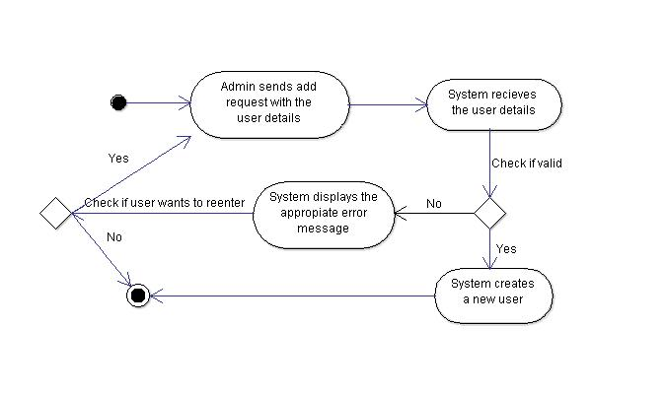
Demo 1: Admin - Add User

Slide 9
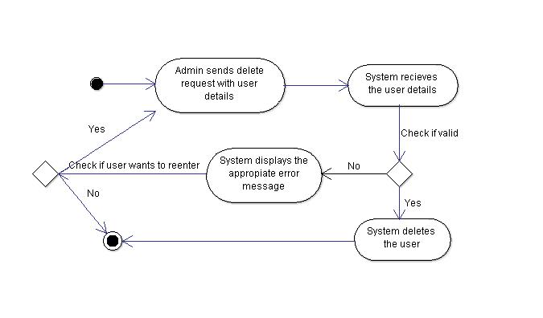
Demo 2: Admin - Remove User

Slide 10
Demo 3-8
Change User Details (Password)
Add Meeting
Reschudule Meeting
Cancel Meeting
Approve Requirements
Generate Report/Backup
From Staff User Perspective

Slide 11
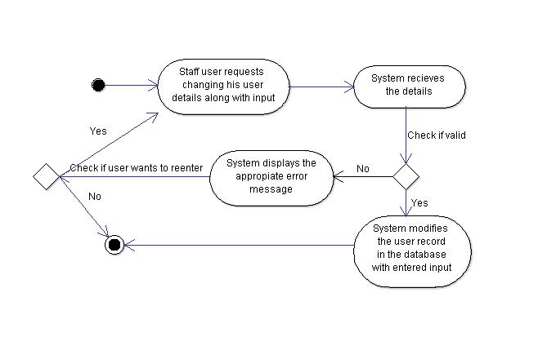
Demo 3: User - Change User Details (Password)

Slide 12
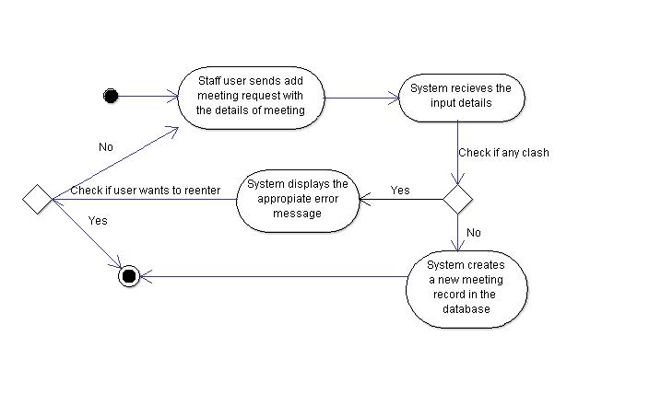
Demo 4: User - Add Meeting

Slide 13
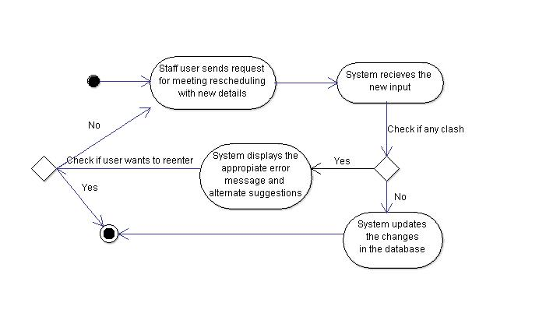
Demo 5: User - Reschedule Meeting

Slide 14
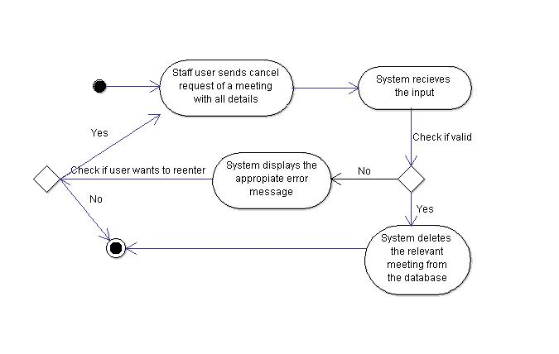
Demo 6: User - Cancel Meeting

Slide 15
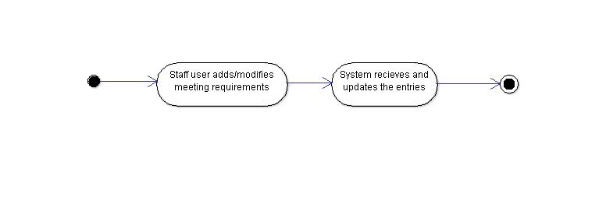
Demo 7: User - Approve Meeting Requirements

Slide 16
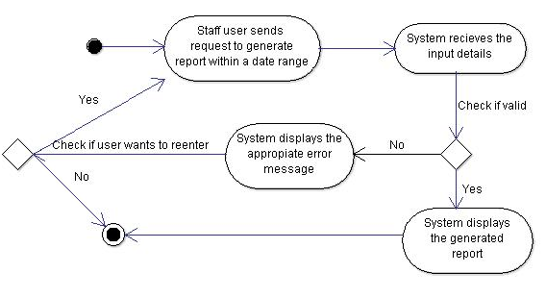
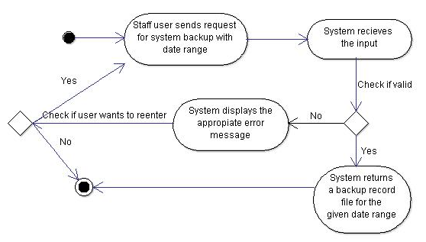
Demo 8: User - Generate Report/Backup

Slide 17
Demo 9
Request Meeting Requirements
From Organizer Perspective

Slide 18
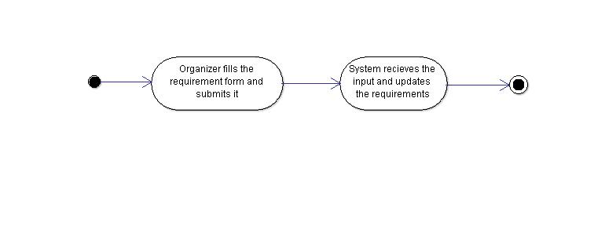
Demo 9: Organizer - Request Meeting Requirements

Slide 19
Demo 10
RSVP for Meeting
From Participant Perspective

Slide 20
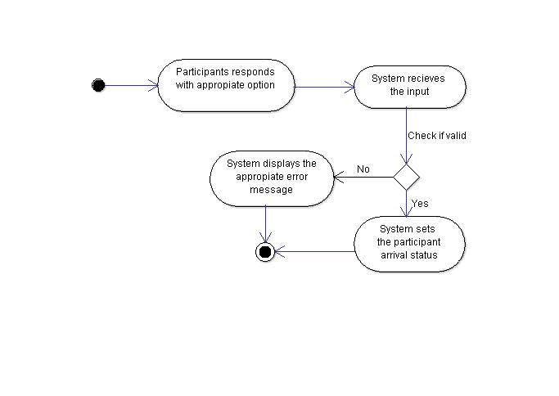
Demo 10: Participant - RSVP for Meeting

Slide 21
Automated Testing
Django Tests
During Development

